Slide 1


Using Multi–Physics Digital Twins for Brake Wear Prognosis of a Mining Vehicle
    Faculty of Engineering,
    Built Environment and
    Information Technology
Luke van Eyk, Brian Ellis, Stephan Schmidt, Stephan Heyns
Centre for Asset Integrity Management (C-AIM)
University of Pretoria

Slide 2
Background
We currently have a research question:
  “How can digital twins be leveraged to enhance the field of predictive maintenance?”
We decided to focus on brake wear prediction.
Why?
Mining Collision prevention systems (CPS) are required by law.
CPS automatically stops a vehicle when a collision is deemed imminent.
CPS needs accurate knowledge of brake performance.
Brake wear predictive maintenance is therefore a highly relevant problem in mining.
Notes:
South Africa has recently mandated the use of collision prevention systems (CPS) in the mining industry.
CPS automatically stops a vehicle when a collision is deemed imminent.
CPS needs accurate knowledge of brake performance to determine stopping thresholds.
We had the research question:
“How can digital twins be leveraged to enhance the field of predictive maintenance for brake pads?”
To find out, we designed a brake wear prediction study.

Slide 3
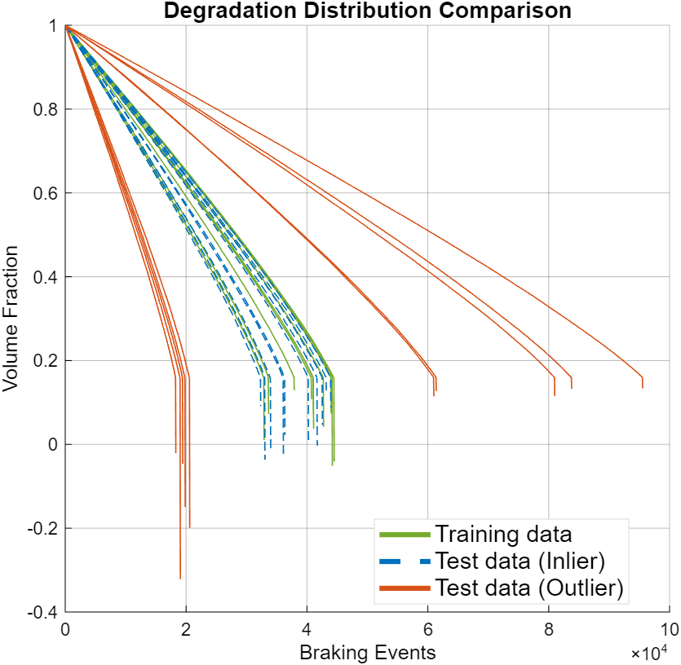
Brake wear experiments
We did not have access to real brake wear data.
We generated our own (beyond today’s scope)
We generated inlier and outlier data.
Inlier: Brake wear similar to history
Outlier: Bad brake pad/new assembly/external factors = unseen wear patterns.
We focus on predicting a single outlier data sample today as it shows the worst case scenario.
Let’s look at a single degradation sample
Notes:
As this is a relatively new field of study, we do not have access to existing brake wear data.
Consequently, we generated representative wear samples (beyond the scope of today).
We will focus on outlier data for today.

Slide 4
A single data sample:
N – Event ID
Wheel speed
Vehicle slope
Vehicle mass
Stop distance
Brake pad temp
Brake Pad Volume
RUL (N)
Only known after failure
Number of Braking Cycles (N)
Notes:
For every braking event in a run to failure sample, we have summary sensor data.
After the brake pad has failed (or been replaced), we are able to label the data with a corresponding Remaining Useful Life value (RUL(N)).
We will now showcase three different models that can estimate the RUL, given sensor data.

Slide 5
Data-driven approach
N – Event ID
Wheel speed
Training data
Vehicle slope
Vehicle mass
Stop distance
Brake pad temp
Brake pad volume
Labels
RUL (N)
Neural network
Number of brake cycles (N)
Model prediction
Underlying truth
Notes:
Firstly, we developed a data-driven PdM approach that inputs the sensor data for each braking event, and has to predict the corresponding RUL value.
It is trained on the trained data shown earlier, and tested on the outlier data.

Slide 6
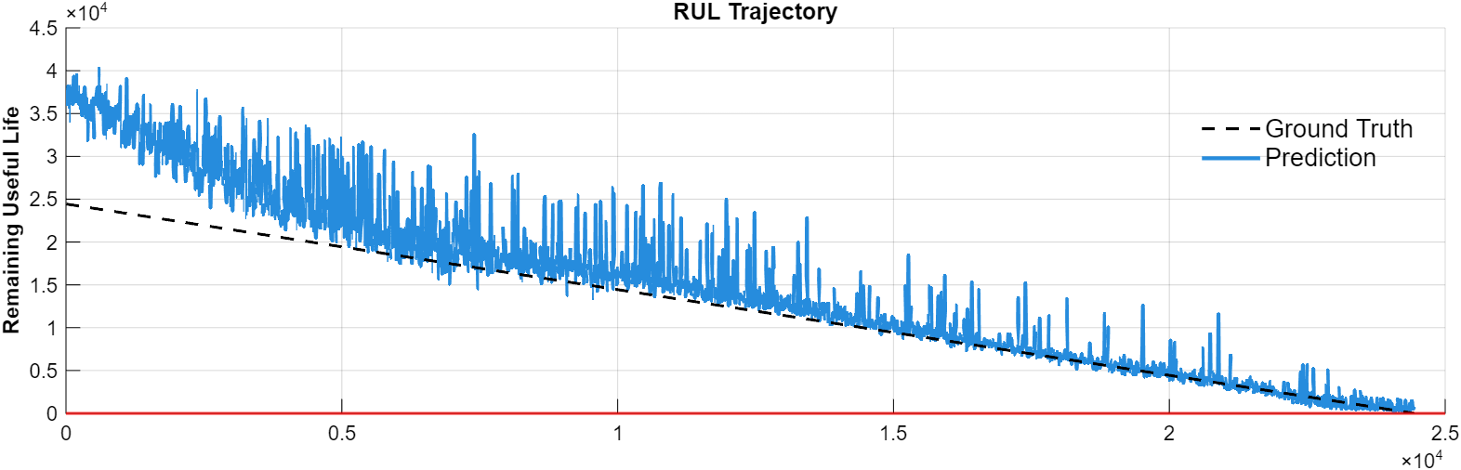
RUL prediction results: Data-driven model
Notes:
Note that these results are for a single outlier sample.

Slide 7


Physics-driven approach
Physics-based wear model
Wear parameter: (experiments)
Brake pressure (historical data)
$$ΔV=K\frac{Pd}{H}$$
Stopping distance (historical data)
Brake pad volume
Pad hardness (experiments)
Missing physics
Number of brake cycles (N)
$$V=V_{0}−∑ΔV$$
Model prediction
Underlying truth
Notes:
The second approach is a physics-driven approach.
Here we do not use live sensor data for RUL prediction, but rather rely on our historical failure data to calibrate a physics-based wear model called the Archard wear model.
Notice that the predicted degradation curve does not match the true underlying curve.

Slide 8
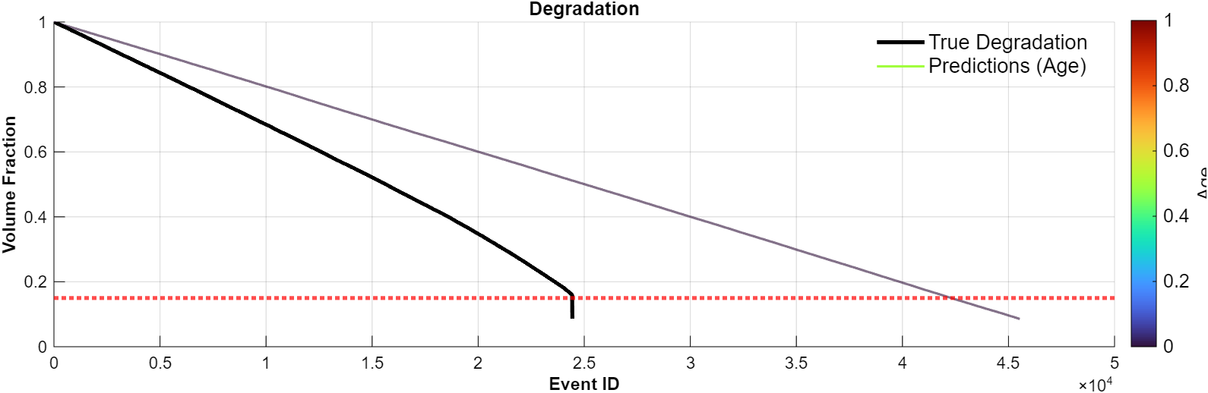
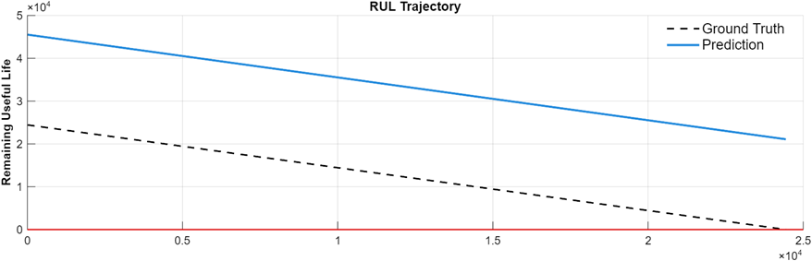
RUL prediction results: Physics-based model
Notes:
Note that these results are for a single outlier sample.

Slide 9

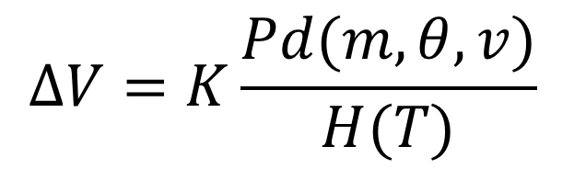
Digital-twin approach
Multi-physics, multi-scale wear model
Vehicle modelling (multi-scale)
Physics-based wear model
$$ΔV=K\frac{Pd(m,θ,v)}{H(T)}$$
$$ΔV=K\frac{Pd}{H}$$
Brake pad volume
Brake pad thermodynamics modelling (multi-physics)
Missing physics
Number of brake cycles (N)
$$V=V_{0}−∑ΔV$$
Model prediction
Underlying truth
Notes:
Here we don’t use data as it is a physics-driven approach.

Slide 10
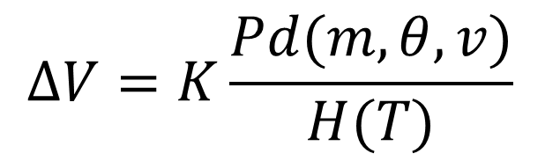
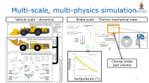
Digital-twin approach
Multi-physics, multi-scale wear model
Vehicle modelling (multi-scale)
$$ΔV=K\frac{Pd(m,θ,v)}{H(T)}$$
Brake pad volume
Brake pad thermodynamics modelling (multi-physics)
Number of brake cycles (N)
$$V=V_{0}−∑ΔV$$
Model prediction
Underlying truth
Notes:
Here we don’t use data as it is a physics-driven approach.

Slide 11
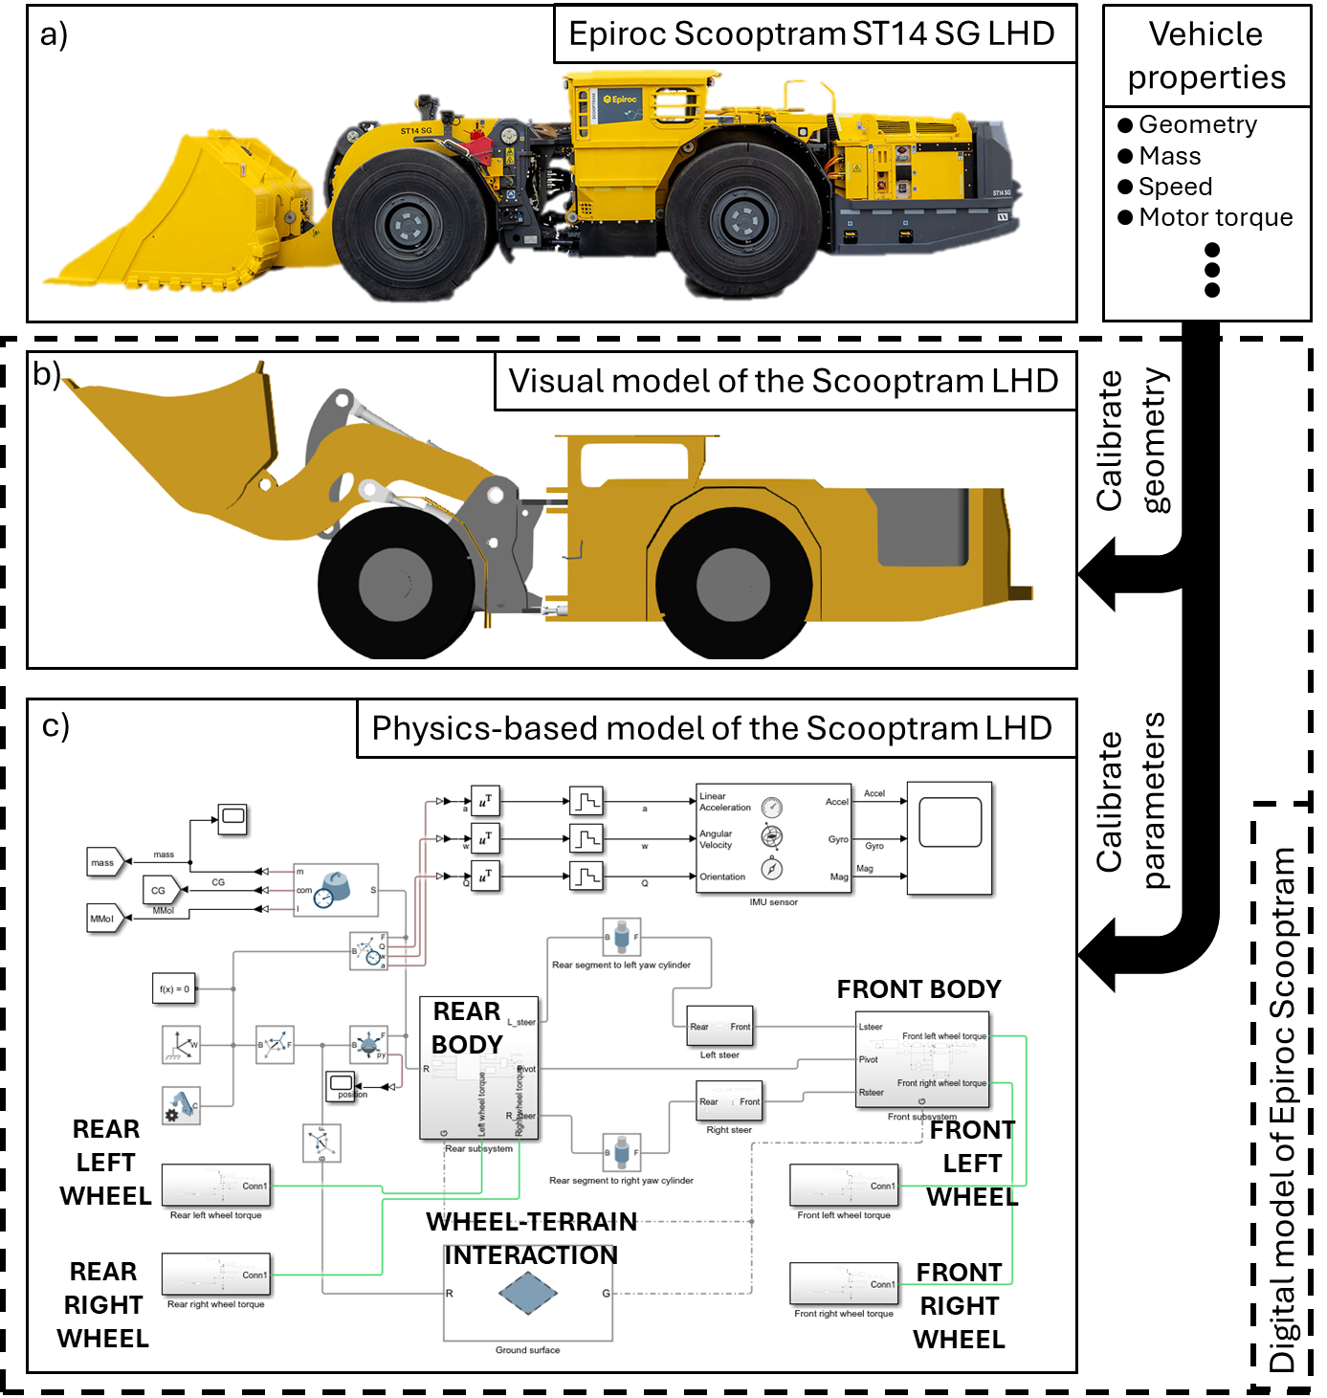
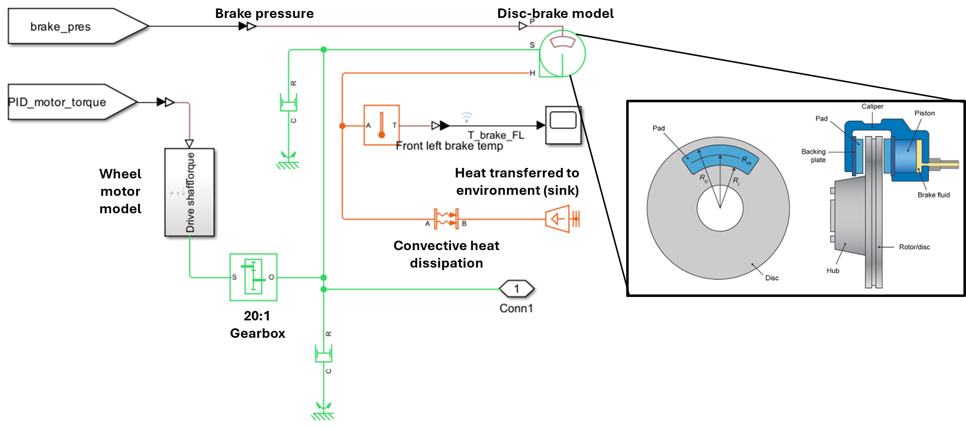
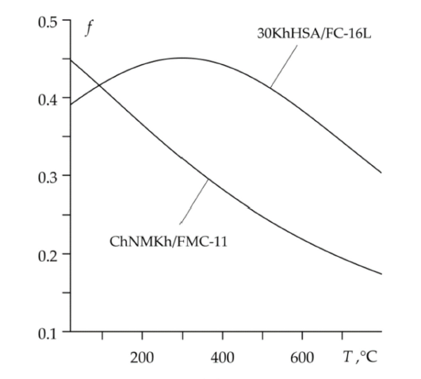

Multi-scale, multi-physics simulation
Vehicle scale - dynamics
Brake scale – Thermo-mechanical wear
Choose brake pad volume
Friction
Temperature ($°C)$
Notes:
The brake pad volume also affects the thermal mass,
which in turn affects how hot the brakes get,
Which in turn have chemical implications for the brake pad hardness.

Slide 12
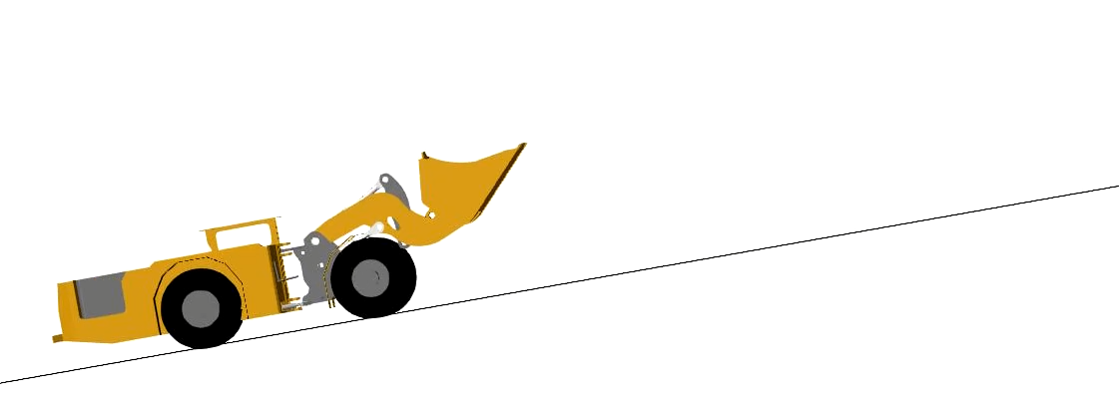
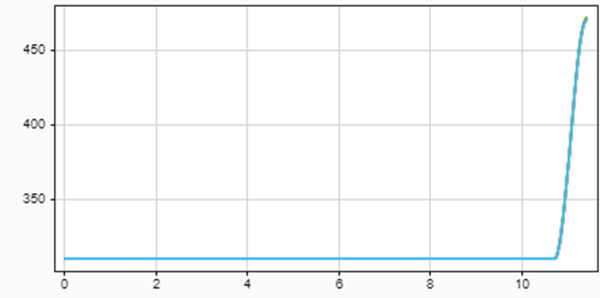
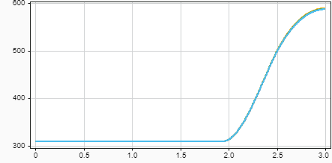
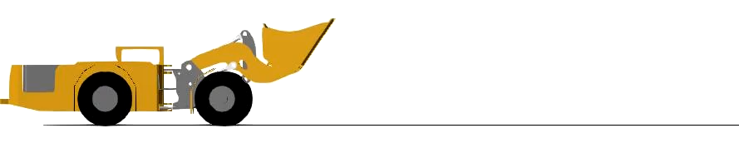
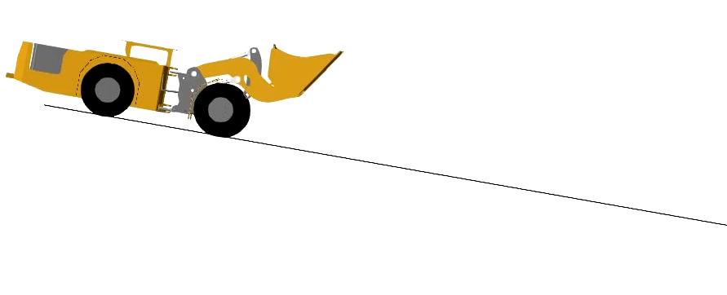
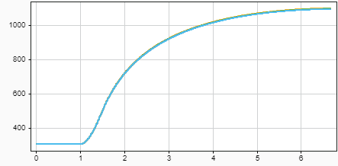
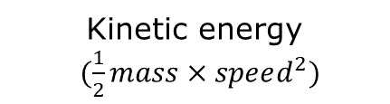
Multi-scale, multi-physics simulation
Vehicle performance lookup table
Brake pad temperature
INPUT:
Mass
Speed
Slope
OUTPUT:
Peak brake temperature
Stopping distance
Stopping distance
SELECT A BRAKE PAD VOLUME AND RUN SIMULATIONS
Stopping distance
Brake pad temperature
Slope
Brake pad temperature
Stopping distance
Kinetic energy
$(\frac{1}{2}mass×speed^{2})$
Notes:
Vehicle dynamics affect the stopping distance.
Show video of vehicle stopping on flat and angled.

Slide 13
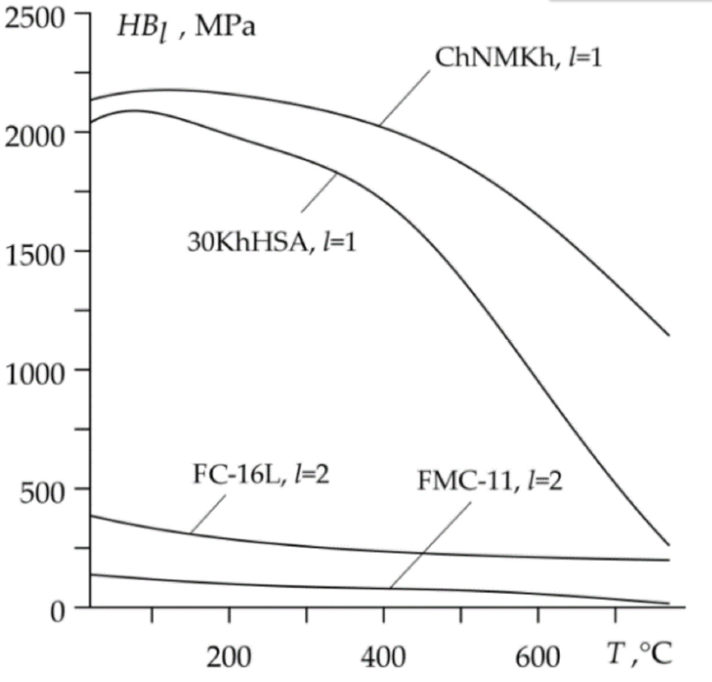
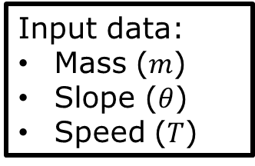
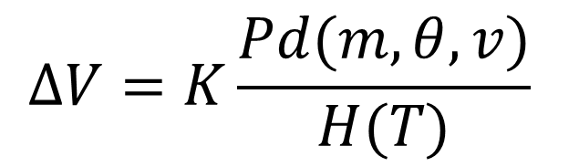

Multi-scale, multi-physics simulation
Input data:
Mass ($m$)
Slope ($θ$)
Speed ($T$)
Lookup stopping distance
Specific lookup for a given brake pad volume
$$ΔV=K\frac{Pd(m,θ,v)}{H(T)}$$
Lookup temperature
Hardness (MPa)
Temperature ($°C)$
Vehicle performance lookup table
Altered wear equation
Notes:
Vehicle dynamics affect the stopping distance.
Show video of vehicle stopping on flat and angled.

Slide 14




Iterative degradation loop:
Pre-generate atlas
Vehicle brake performance atlas
Map 1: 100% Volume
Run degradation loop
$$ΔV=K\frac{Pd(m,θ,v)}{H(T)}$$
Map 2: 99% Volume
$$ΔV=K\frac{Pd(m,θ,v)}{H(T)}$$
Run degradation loop
Map 3: 98% Volume
$$ΔV=K\frac{Pd(m,θ,v)}{H(T)}$$
Run degradation loop
Map 100: 1% Volume
FAILURE
$$V=V_{0}−∑ΔV<V_{fail}$$
Notes:
The brake pad volume also affects the thermal mass,
which in turn affects how hot the brakes get,
Which in turn have chemical implications for the brake pad hardness.

Slide 15
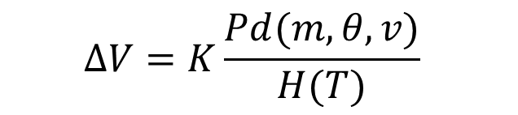


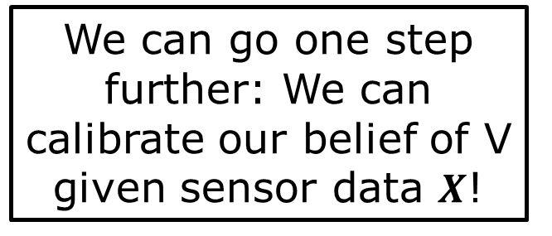
Digital twin approach (we can do better)
Multi-physics, multi-scale wear model
$$ΔV=K\frac{Pd(m,θ,v)}{H(T)}$$
$$V=V_{0}−∑ΔV$$
$$V(X)=V_{0}−∑ΔV$$
We can go one step further: We can calibrate our belief of V given sensor data $X$!
Brake pad volume
Number of brake cycles (N)
Model prediction
Underlying truth
Notes:
Here we don’t use data as it is a physics-driven approach.

Slide 16
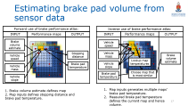
Digital twin approach (we can do better)
Multi-physics, multi-scale wear model
$$ΔV=K\frac{Pd(m,θ,v)}{H(T)}$$
$$V(X)=V_{0}−∑ΔV$$
We can go one step further: We can calibrate our belief of V given sensor data $X$!
Brake pad volume
Number of brake cycles (N)
Model prediction
Underlying truth
Notes:
Here we don’t use data as it is a physics-driven approach.

Slide 17
Estimating brake pad volume from sensor data
Forward use of brake performance atlas:
Inverse use of brake performance atlas:
INPUT
Performance maps
OUTPUT
INPUT
Performance maps
OUTPUT
Brake volume estimate
Vehicle speed
Stopping distance
Vehicle mass
Vehicle speed
Brake volume estimate
Lookup map temperatures
Brake pad temperature
Vehicle slope
Vehicle mass
Brake pad temperature
Choose map that is most similar
Vehicle slope
1. Brake volume estimate defines map
2. Map inputs defines stopping distance and brake pad temperature.
Map inputs generates multiple maps’ brake pad temperature.
Measured brake pad temperature defines the current map and hence volume.

Slide 18
Digital twin approach (we can do better)
Multi-physics, multi-scale wear model
$$ΔV=K\frac{Pd(m,θ,v)}{H(T)}$$
$$V(X)=V_{0}−∑ΔV$$
Brake pad volume
Number of brake cycles (N)
Model prediction
Underlying truth
Notes:
Here we don’t use data as it is a physics-driven approach.

Slide 19
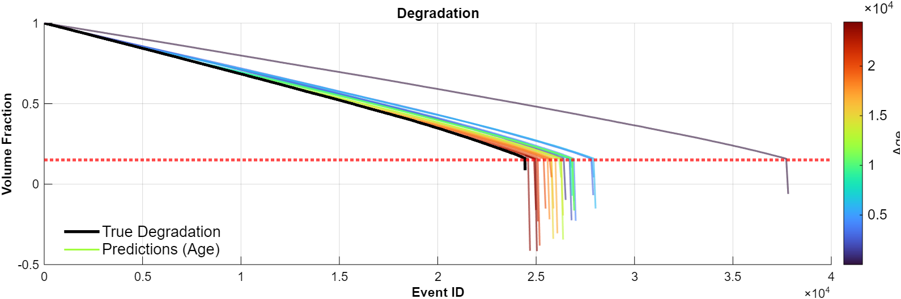
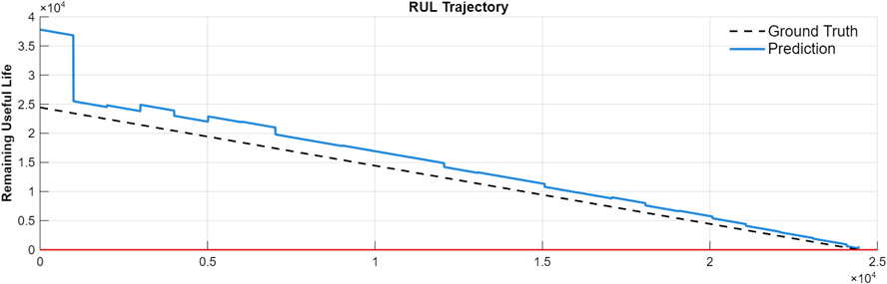
RUL prediction results: Digital twin
Notes:
Note that these results are for a single outlier sample.

Slide 20
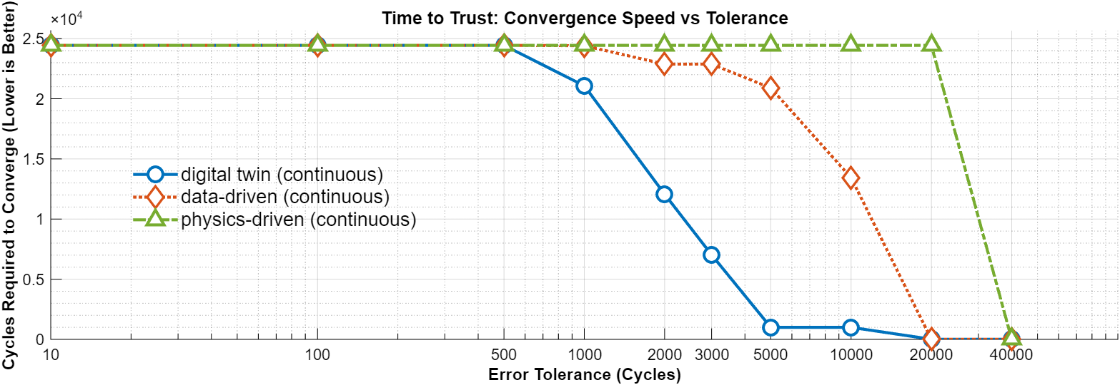
Error convergence meta analysis

Slide 21
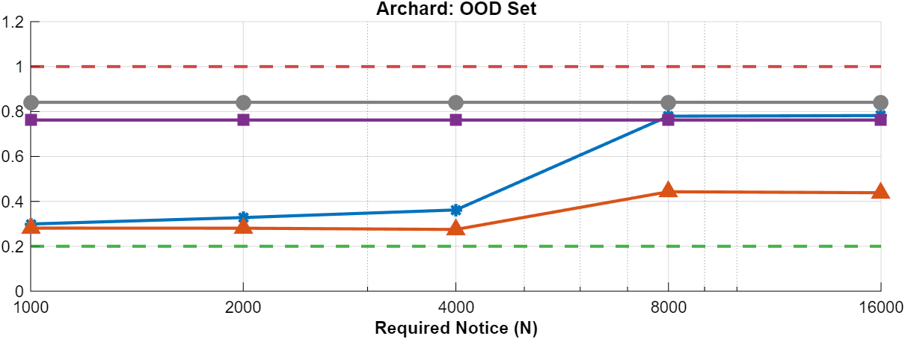
Cost results:
Maintenance cost assuming a 1000 cycles safety margin
Corrective maintenance
Preventive maintenance
Physics-based model
Data-driven model
Digital twin
Perfect predictive maintenance
Increasing asset size and complexity
Notes:
This is when we have 10 historical failure examples, and we evaluate on 10 OOD samples.
Normalised cost, where Cc is 1 and C of perfect predictive is 0.2. Everything else is scaled in-between.
We do this to evaluate the robustness of methods to unseen fault conditions.
For large expensive assets, we likely need a longer notice period.
For smaller assets like brake pads, we are likely content with operating on a small required notice.

Slide 22
Concluding remarks
Modelling at multiple scales (vehicle dynamics and wear) across multiple physics domains (wear mechanics and brake fade thermodynamics) allowed us to build a brake wear digital twin that:
  Is robust to outlier data
  Can converge on the true remaining brake pad life earlier in a brake’s life.
  Is interpretable: continuously outputs not only RUL, but also brake pad volume fraction.
The general principle outlined in this work can be extended to predictive maintenance of other assets as well.

Slide 23

Comments & Questions?

