Slide 1


Enhancing Condition Monitoring of Mining Vehicles Using Physical Models and Transfer Learning
Presenter: Luke van Eyk
Supervisors: Prof PS Heyns, Dr S Schmidt
Centre for Asset Integrity Management (C-AIM)
University of Pretoria

Slide 2
Context
Digitization = Instrumented fleets
Large amount of operational data being captured
How can we use this data to determine useful KPIs?
These KPIs are typically difficult/impossible to measure in real time:
  Fuel usage - Production
  Engine temperature – Condition monitoring (Today’s focus)
  LHD Bucket load/volume
  etc.
How would such correlations typically be done?
Notes:
Key here is that we want real time feedback!

Slide 3
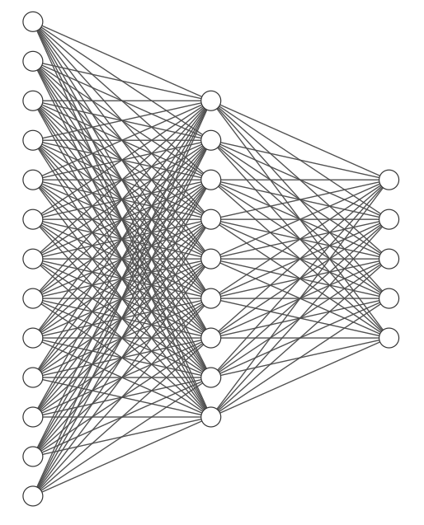
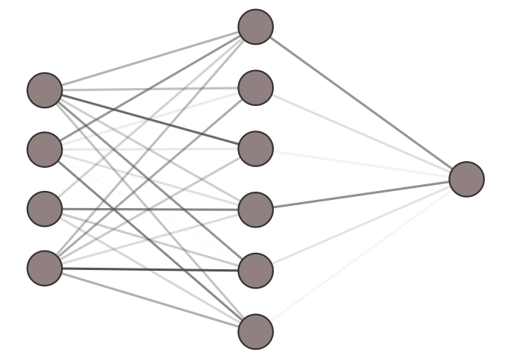
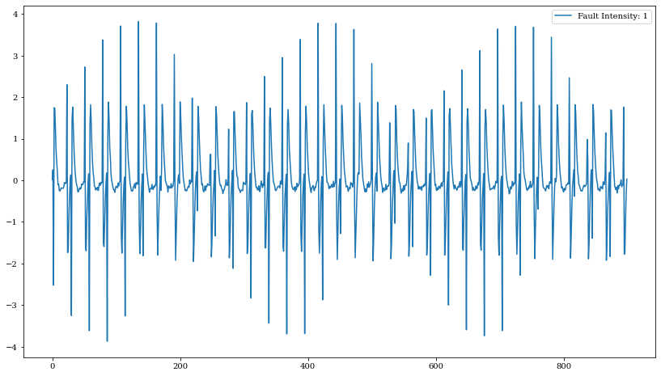





Common supervised learning framework:
Very few or ZERO labels!
Real data + labels
Feature Extractor
Label predictor
Machine KPI Prediction
Features
$$f_{1}$$
$$f_{2}$$
Engine Temp: 400 K
Fuel Usage:
0.1 l/min
Load hauled:
4.5 tons
$$f_{3}$$
$$f_{n−1}$$
$$f_{n}$$
Notes:
Our “knowledge” comes from a few labelled samples
Or we don’t have any knowledge if we don’t have labelled data
Can we use existing data to determine some “harder” quantities, without necessarily having their labels? Thus regression without sensors. ;

Slide 4
Current problem
We can see that these supervised methods rely on labels
We don’t have labels
What can we do?
  Part 1: Hybrid model for data generation/training
  Part 2: Transfer learning for model calibration

Slide 5
A hybrid methodology:
Physical reality (Machine)
Data
Known physics
Unknown physics
Physics-driven model
Data-driven model
Decision-making
Hybrid model
Notes:
In this sense, we hope that the data can capture elements of the physical reality that our physical model could not.

Slide 6
Hybrid model for diagnosis
Conceptualisation
Data-Driven
Increasing Predictive Accuracy
Physics-Driven
Data-Driven
Physics-Driven
Hybrid
Hybrid
Increasing Labelled Data

Slide 7





Proposed hybrid approach
Physics-driven
Data-driven
Hybrid
Simulated data
Feature Extractor
Label predictor
Machine KPI Prediction
Features
$$f_{1}$$
$$f_{2}$$
Engine Temp: 400 K
Fuel Usage:
0.1 l/min
Load hauled:
4.5 tons
$$f_{3}$$
$$f_{n−1}$$
$$f_{n}$$
Notes:
Here our knowledge comes from the simulations.

Slide 8
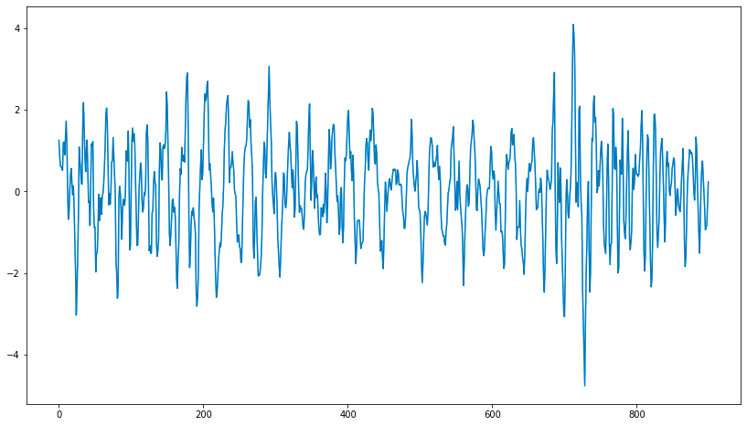
Shortcoming of this method
Contains some useful information about the system, but calibrated to input data
Numerical/Training Data
Data-driven
Machine KPI prediction
Hard divide
?
Data-driven
Machine KPI prediction
Alternate/Real Data
Notes:
The simulation-trained ML model will not necessarily generalize well to data from the real/similar asset
May not even generalize within the same asset for different operating conditions!
We have, however, learnt some useful info from numerical data
How do we “transfer” this info to a ML model which receives a different input dataset?

Slide 9
Solution: Transfer learning
Source Domain
Machine KPI prediction
Data-driven
Transfer information
Data-driven
Target Domain
Notes:
Transfer learning is a field of machine learning focused on tackling exactly this problem:
How do we transfer knowledge from one domain of data to another.
Some terminology:
Source domain
Domain on which initial model was trained.
We have lots of data + labels.
Model mainly trains on this data
Target domain:
Domain in which model is to be applied
We have data but very few or no label

Slide 10










Transfer learning structure
Source data
Feature Extractor
Label predictor
Features
$$f_{s1}$$
$$f_{t1}$$
$$f_{s2}$$
$$f_{t2}$$
$$f_{s3}$$
$$f_{t3}$$
$$f_{sn−1}$$
$$f_{tn−1}$$
$$f_{sn}$$
$$f_{tn}$$
Target data
Machine KPI Prediction
Source
Target
Compare and penalize if not similar
Joint Task
Notes:
The following structure is used to transfer knowledge:
Model is jointly incentivized to produce similar feature distributions, regardless of input domain
Model is also incentivized to produce accurate labels from the features it receives.
Labels only need to be available for source domain.
Can still pass labels for target domain if available – Power of this technique

Slide 11


Investigation of transfer learning utility
Simulated vehicle
Vehicle Vibrations
Known during training
Throttle Position
Data-driven model
Engine RPM
Engine exhaust manifold temperature prediction
Engaged Gear no.
Fuel Flow Rate
Transfer learning calibration
Hidden during training
Vehicle Vibrations
Throttle Position
Data-driven model
Engine exhaust manifold temperature prediction
Engine RPM
Engaged Gear no.
Fuel Flow Rate
Real vehicle with limited instrumentation
Fleet

Slide 12
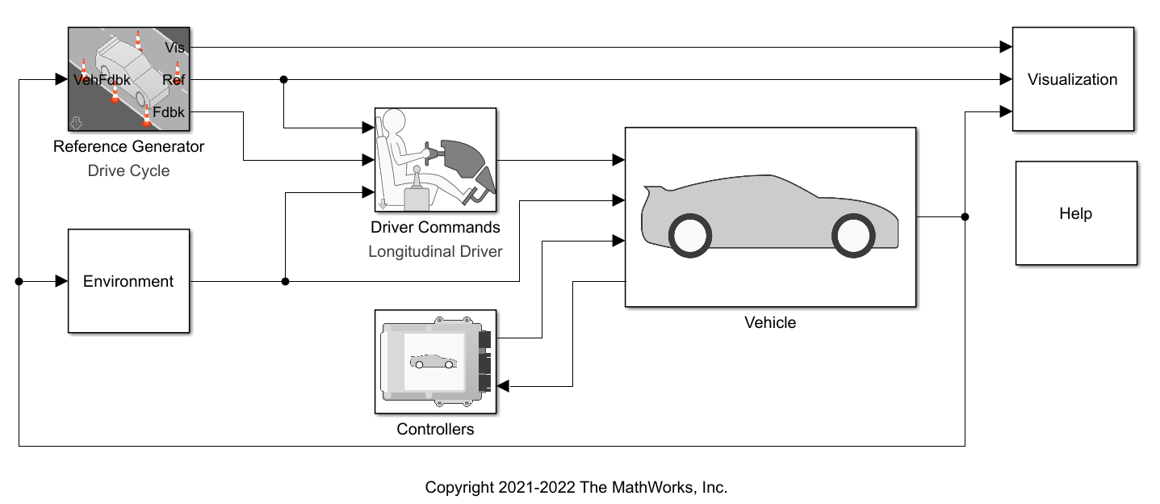
Numerical study on vehicle:
Notes:
I don’t have time to go into detail, but in this study, I simulated a vehicle in Matlab
As input to the hybrid framework model, I simulated:
Vibrations
Throttle position
Engine RPM
Current gear
Fuel flow rate
As output, I tried to predict the engine exhaust temperature.
I have a different source and target domain
Note that this is for a car, but the concept quite easily extends to mining vehicles.

Slide 13
Numerical study on vehicle
Input data:
Data-driven model
Vehicle Vibrations
Throttle Position
Engine exhaust manifold temperature prediction
Engine RPM
Engaged Gear no.
Fuel Flow Rate
Notes:
I don’t have time to go into detail, but in this study, I simulated a vehicle in Matlab
As input to the hybrid framework model, I simulated:
Vibrations
Throttle position
Engine RPM
Current gear
Fuel flow rate
As output, I tried to predict the engine exhaust temperature.
I have a different source and target domain
Perhaps expand on the fact that for the target domain,

Slide 14
Domains
Source domain: Simulated vehicle with engine temperature known to data-driven model
Target domain: Different simulated vehicle without engine temperature known to model

Slide 15
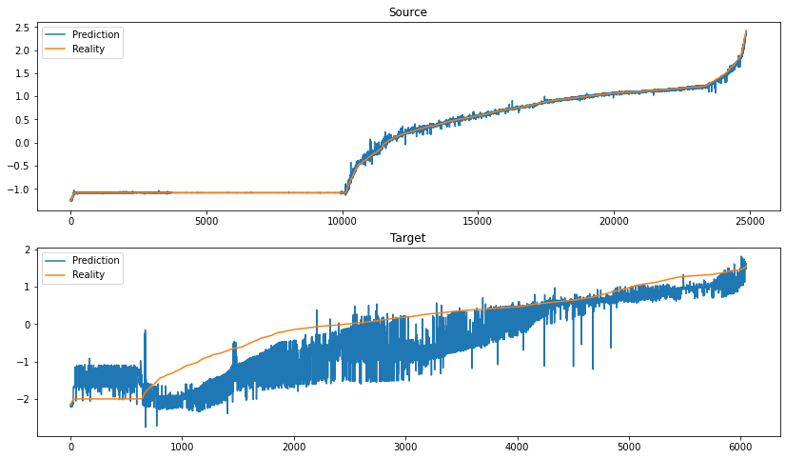
Source domain (temperatures known)
Good results because we have labels
Source domain
Exhaust Temperature
(Standardised)

Slide 16
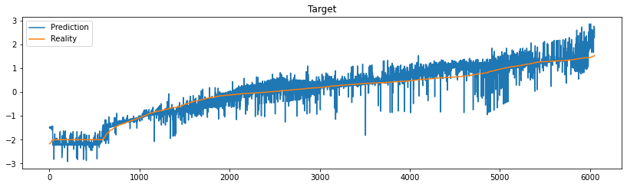
Results: Engine temperature predictions for unseen vehicle
Target (No calibration)
Prediction
Remember we have no labels for training. Only raw sensor data (no temperature data as reference)
Exhaust Temperature
(Standardised)
Truth
Target (Calibrated by transfer learning)
Prediction
Truth
Exhaust Temperature
(Standardised)
Notes:
Over the range of temperature predictions, we sorted them from small to large and evaluated the accuracy of the non-transfer vs. transfer method.
Clearly there is a benefit to transfer-learning.
Important to remember we did not have this regressive information during training. We only have the relationships between inputs and outputs of SOURCE domain and infer the relevant mapping to the target domain.

Slide 17
Conclusions
Hybrid methods allow us to:
  Model known physics
  Infer unknown physics
  Use knowledge from both
However, they suffer when target data differs from source
Transfer learning helps us calibrate for these differences
Hybrid + Transfer is a recipe for exciting diagnostic potential

Slide 18
Applications
Simulate a vehicle (with labels) and transfer to real vehicle (with no labels)
Take a vehicle full of sensors and transfer knowledge to unknown vehicle
Or fleet
This engine temperature example:
  Virtual sensor
  Anomaly detection sensor

Slide 19
Thank you
Any questions or comments are welcome
Contact details:
Luke.vaneyk@up.ac.za

